Slide 1
Judgment and Decision Making
Sumitava Mukherjee

Slide 2
The basics of a judgment or decision
Perception
Attention
Learning
Memory
Emotions
Personality (Individual differences)
Value
Uncertainty
Constraints
Action

Slide 3
How do we decide?
Percept + Attention
Memory + Learning
Developmental + Genetic + Ecological
  Description-based decisions
  Experience-based decisions

Slide 4
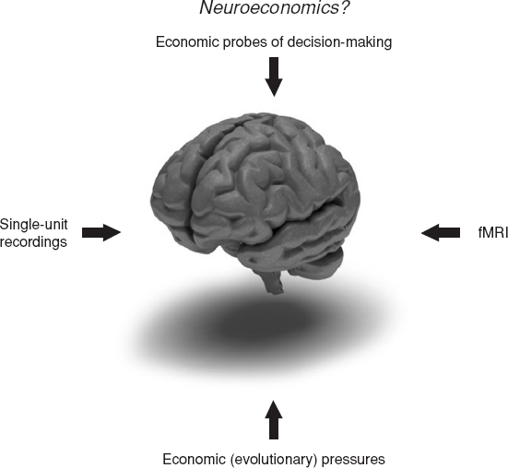
Approaches

Slide 5
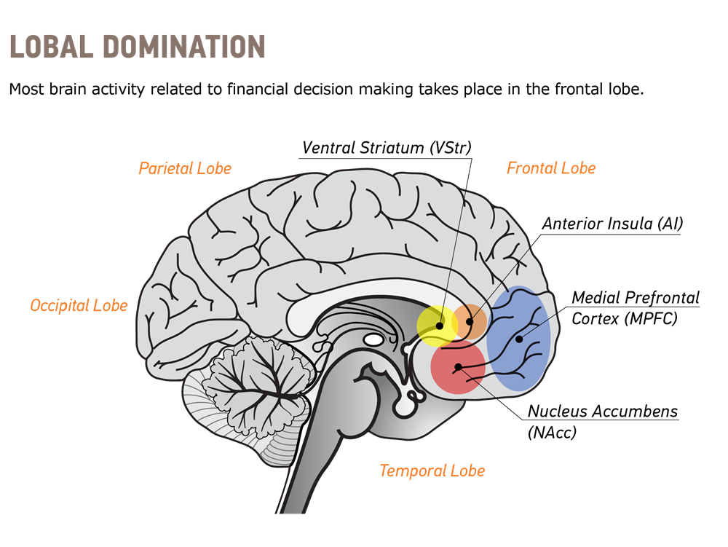
Basic areas in the brain

Slide 6
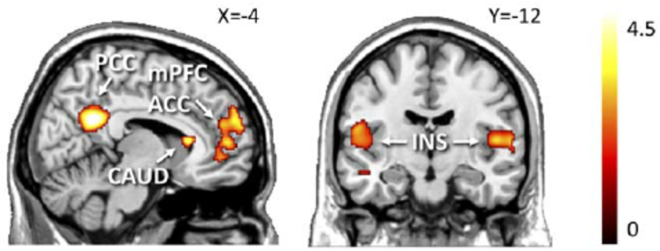
Representing value

Slide 7
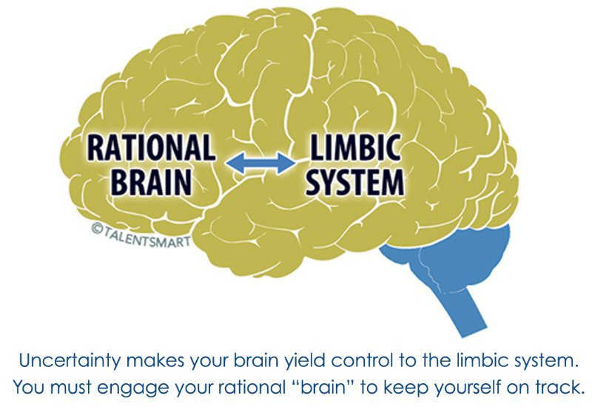
The advantages of uncertainty

Slide 8
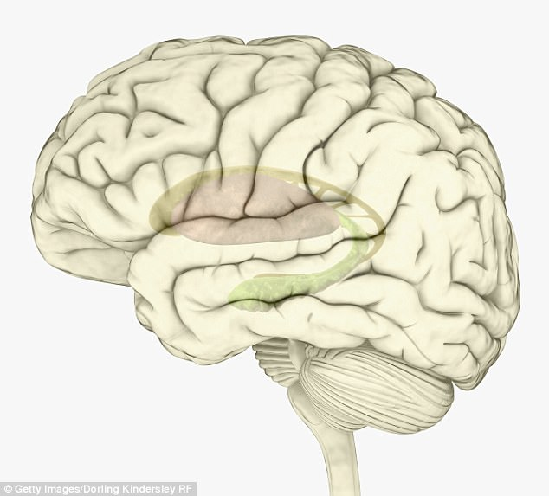
Converging importance: Affect

Slide 9
What happens in a judgment?
The real question
Understanding the real question
Feeling the question
Feeling the answer to the question

Slide 10
Cognitive Processes
Search for information
Memory traces (fuzzy, network)
Potential outputs as answers
Selection of the answer

Slide 11
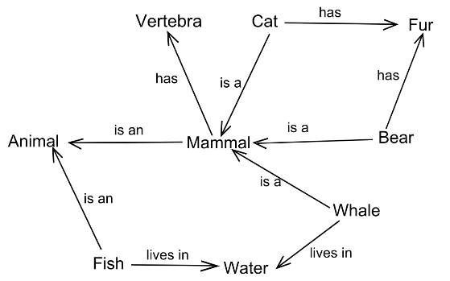
Recap on memory
Semantic network
Recency
Familiarity

Slide 12
Availability Heuristic : Finding instances
What percent of people in the age group of 30-40 get a divorce?
Which is the most polluted city in India?
How many yearly road accidents take place in New Delhi on average?

Slide 13
Feeling the judgment you make
Cognitive Ease (Easy – Strained)
Situation 1: No major event, no need of reorienting, no flag, no effort
Situation 2: Need for effort, unmet demands, cognitive strain
Cognitive ease is connected to a large network of diverse inputs and outputs.

Slide 14
Cognitive Ease
Repeated experience, -> Feels familiar
Clear display, -> Feels true
Primed Idea, -> Feels good
Good mood -> Feels effortless

Slide 15
Persuasion using cognitive ease
Adolf Hitler was born in 1892
Adolf Hitler was born in 1887

Slide 16
Mansoma
Kadigra
Mansoma
Sattick,
Mansoma
Ikitaf

Slide 17
Which word do you think means something good?
Mansoma or Kadigra

Slide 18
Mere exposure effect
Repeating increases value (Zajonc)
Does not depend on conscious experience of familiarity
Adaptive to value repetition for all animals when not followed by anything bad.

Slide 19
Ease of processing and decision quality
If it takes 5 machines, 5 minutes to complete 5 widgets, how much time will it take 100 machines to complete 100 widgets?

Slide 20
What is the value of this?
1x2x3x4x5x6x7x8

Slide 21
What is the value of this?
8x7x6x5x4x3x2

Slide 22
A lead Number
Is the height of the sunrhondeon tree higher than 17 ft? What is your best estimate?
Is the height of the deohonsu tree higher than 3 ft? What is your best estimate?

Slide 23
Anchoring effect
When: People use a value for an unknown quantity before estimating the quantity.
The later estimates stay closer to the number previously considered
Explanation
  Priming
  Insufficient adjustment

Slide 24
TWO SYSTEMS
SYSTEM 1 – Operates automatically and quickly with little effort without sense of voluntary control most of the time
SYSTEM 2 – Operates by allocating attention to effortful mental activities and is often associated with subjective experience of agency, choice and concentration

Slide 25
TWO SYSTEMS but interacting with each other
SYSTEM 1 – Originate impressions and feelings, (semi) automatic operations, can generate surprisingly complex pattern of ideas
SYSTEM 2 – The impressions and feelings gives rise to explicit beliefs and choices. Can work through a series of organized steps. Can guide the functioning of system 1 through programming attention and memory

Slide 26
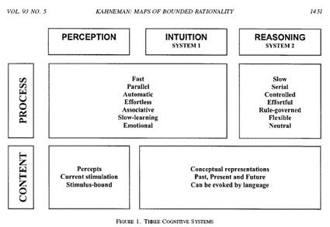
Cognitive maps for bounded rationality
© American Economic Association.
Used here for academic demonstration only

Slide 27

Daily examples

Slide 28
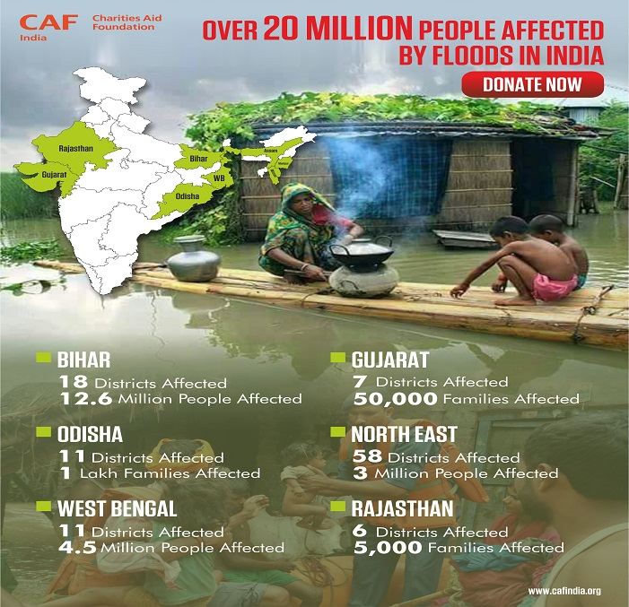
Daily examples
Psychic Numbing

Slide 29
Daily examples
Our main aim is to make sure that children go to school
so that we can reduce illiteracy and a lack of education
thus reducing unemployment
Vs
Our main aim is to make sure that children go to school
so that they they learn how to read and thus
realize their ambitions and dreams

Slide 30
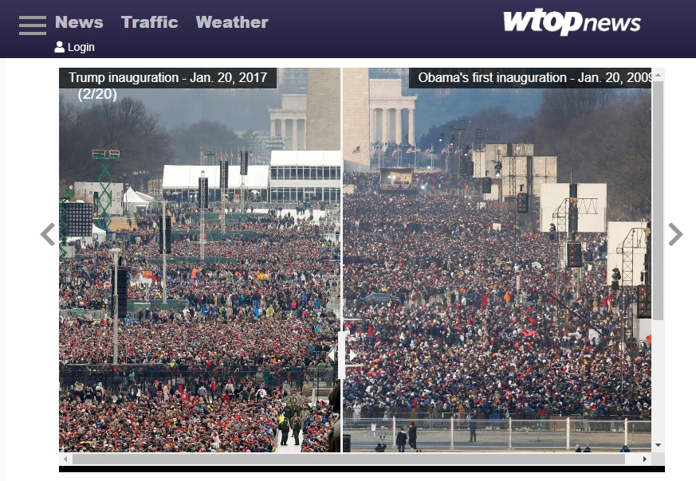
Daily examples

Slide 31
Summing up
Affective systems entwined with deliberative systems
Key aspects of a decision: value, uncertainty, constraint
Pervasive role of learning, memory (and context)
Importance of evolutionary and ecological inputs
Judgments and Decisions encompass almost all psychological processes. That is life!

